Slide 1
Child Day Care Services
INSTRUCTOR : NURCAN YURUK
COURSE : CS6360.002
PRESENTED
BY
TEJA MUKKA (txm162230)
DILEEP GUDENA (dxg161730)
KRUPALI CHANDRAKANTBHAI PATEL (kxp160630)
April 26, 2017
DATABASE FINAL PROJECT

Slide 2
Data Requirements for the System
A parent enrolls a child at child day care center. He/she only one of them can enroll one or more children to the Day care.
Each child has unique child id, child last name, child first name, date of birth and also mandatory emergency contact person name and phone number.
Every child pays the child care fees. This will be a fixed recurring payment on monthly basis.
A child can attend only one class.
The class can be uniquely identified using class id and each class also have other attributes like room number and the location.
Each class has different set of toys in various quantities.
The toys can be uniquely identified by toy_id and it has other attributes like toy name, date of purchase, manufactured company and the total quantity of each toy.

Slide 3
Data Requirements for the System (Continued)
Each class section is solely handled by one teaching _staff member.
Staff and teaching staff belongs to the caretaker. They can not play both the roles and hence they are disjoint roles.
Each child has a specific list of food that he/she can consume.
Food can be ordered by many staff members and each staff members can order food many times.
Timing records are maintained for each caretaker.
Job, Caretaker and timing are in a ternary relationship. The salary for each caretaker is computed by retrieving the job type for which there will be a fixed salary and computed against the cumulative sum of timeout – timein for various days.
Each care taker will have job level assigned to them.

Slide 4
Data Requirements for the System (Continued)
One of the caretakers also plays the managerial role and manages the care takers.
There are two different departments, staff and teaching staff and each of them will have separate manager. There will be a supervisor for both the departments.
Each care taker belongs to department.
Each department has only one manager.

Slide 5
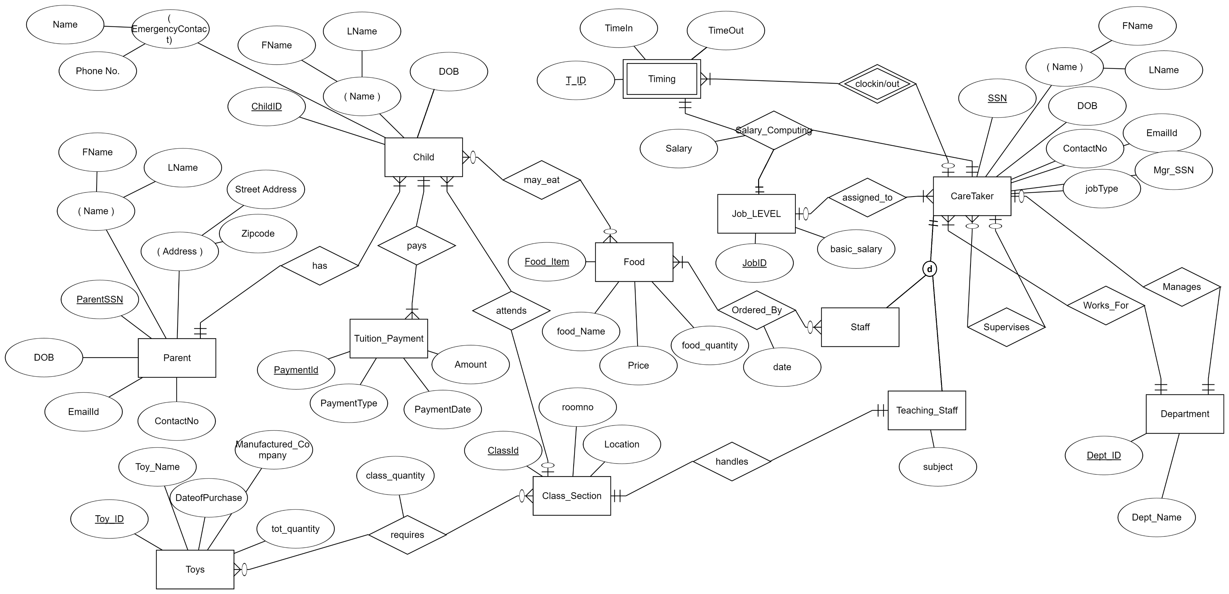
ER Diagram

Slide 6
Relational Schema
Child
Parent
Toys
Child_Id | FName | LName | DoB | EName | Ephone | P_SSN | Cls_Id
ParentSSN | FName | LName | DoB | Email_Id | ContactNo | Street Address | Zipcode
Toy_Id | Toy_Name | Date_of_Purchase | Compay | Total_quantity

Slide 7
Relational Schema (Continued)
Toy_Distribution
Tuition_Payment
Class_Section
Toy_Id | Class_Id | Class_Quantity
Payment_Id | PaymentType | Date | Amount | Child_Id
Class_Id | Room | Location | Class_Teacher

Slide 8
Relational Schema (Continued)
Timing
CareTaker
Food
CareTaker_SSN | Timing_Id | TimeIn | TimeOut
CSSN | FName | LName | DoB | Contact | Email_Id | JobType | Subject | Job_Id | Mgr_SSN | Dept_ID
Food_Id | Food_Name | Price | Food_Quantity

Slide 9
Relational Schema (Continued)
Food_OrderedBy
Food_Record
Job
Staff_SSN | Food_Id | date
Child_ID | F_ID
Job_Id | basic_salary

Slide 10
Relational Schema (Continued)
SalaryComputation
Department
CareTakerSSN | Timing_Id | Job_Id | Salary
Dept_ID | Dept_Name | Mgr_SSN

Slide 11
Procedures
CREATE OR REPLACE PROCEDURE CLASS_LIST
( CLASS_ID IN CHILD.CLASS %TYPE) AS
CHILD_ID CHILD.CHILD_ID%TYPE;
CHILD_FNAME CHILD.FNAME%TYPE;
CURSOR RESULT IS
(SELECT CHILD_ID,FNAME
FROM CHILD WHERE CLASS_ID=CLASS);
BEGIN
OPEN RESULT;
LOOP
FETCH RESULT INTO CHILD_ID,CHILD_FNAME;
EXIT WHEN (RESULT%NOTFOUND);
DBMS_OUTPUT.PUT_LINE
('CHILD_ID IS ' || CHILD_ID || ' CHILD NAME IS '||CHILD_FNAME);
END LOOP;
CLOSE RESULT;
END;

Slide 12
Procedures (Continued)
CREATE OR REPLACE PROCEDURE TOTAL_FEE
(ID IN NUMBER) AS
FEE NUMBER:=0;
BEGIN
SELECT SUM(AMOUNT) INTO FEE
FROM TUITION_PAYMENT
WHERE CHILD_ID =ID;
DBMS_OUTPUT.PUT_LINE('TOTAL FEES PAID BY CHILD IS '||FEE);
END;

Slide 13
Procedures (Continued)
CREATE OR REPLACE PROCEDURE TOTAL_FEE
(ID IN NUMBER) AS
FEE NUMBER:=0;
BEGIN
SELECT SUM(AMOUNT) INTO FEE
FROM TUITION_PAYMENT
WHERE CHILD_ID =ID;
DBMS_OUTPUT.PUT_LINE('TOTAL FEES PAID BY CHILD IS '||FEE);
END;

Slide 14
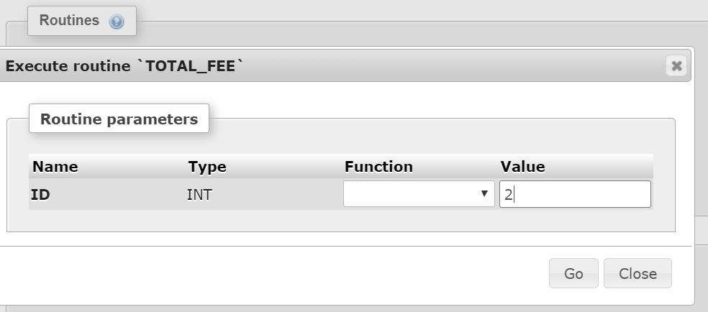
Procedures (Continued)

Slide 15
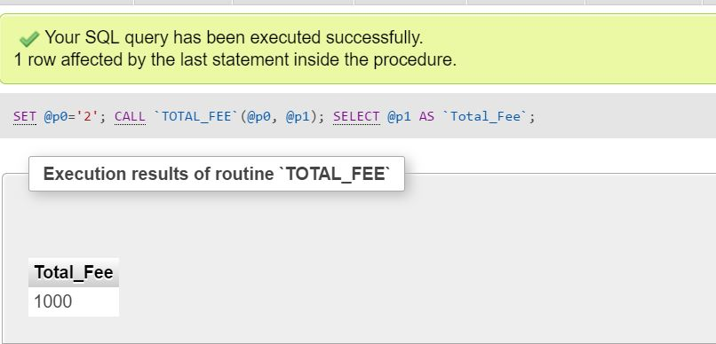
Procedures (Continued)

Slide 16
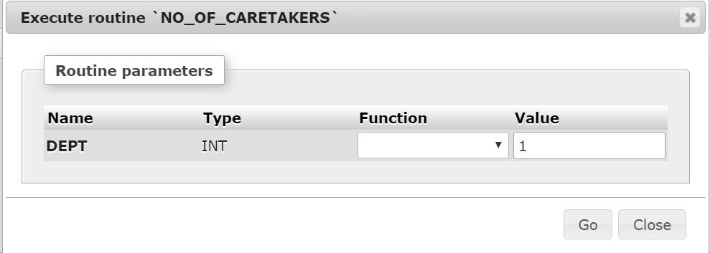
Procedures (Continued)

Slide 17
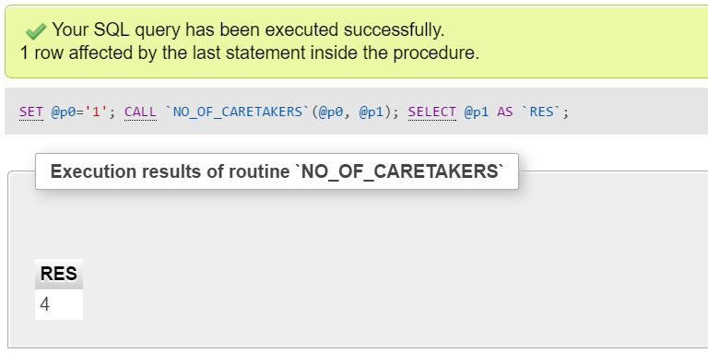
Procedures (Continued)

Slide 18
Triggers
CREATE OR REPLACE TRIGGER TOYS_UPDATE
AFTER INSERT ON TOY_DISTRIBUTION
FOR EACH ROW
BEGIN
UPDATE TOYS
SET TOTAL_QUANTITY=TOTAL_QUANTITY - :NEW.QUANTITY
WHERE T_ID=:NEW.TOY_ID;
END;

Slide 19
Triggers(Continued)
create or replace TRIGGER SALARY_COMPUTE
AFTER INSERT ON TIMING
FOR EACH ROW
DECLARE
BASICSALARY INT;
SALARYCOMPUTED INT;
CSSN CHAR(9);
JID INT;
BEGIN
SELECT C.CSSN,C.JOB_ID,J.BASIC_SALARY INTO CSSN,JID,BASICSALARY FROM CARETAKER C JOIN JOB J ON J.JOB_ID = C.JOB_ID
WHERE C.CSSN = :NEW.CSSN;
SALARYCOMPUTED := ((TIMEOUT-TIMEIN)*BASICSALARY)/10000;
INSERT INTO SALARYCOMPUTATION
VALUES(CSSN,:NEW.TIME_ID,JID, SALARYCOMPUTED);
END;

Slide 20
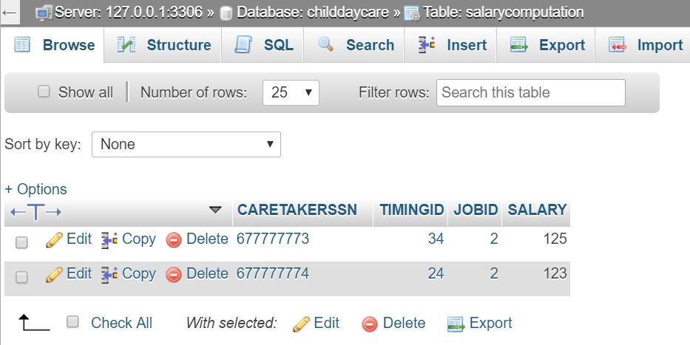
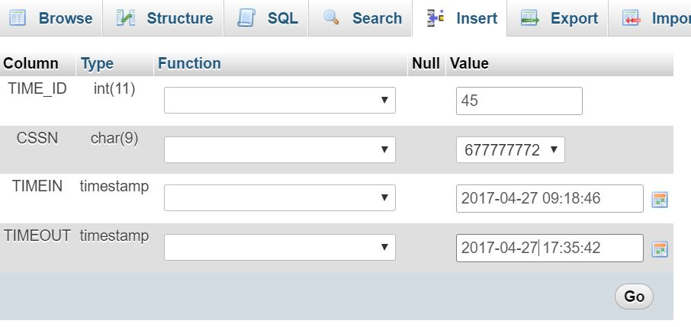
Triggers(Continued)

Slide 21
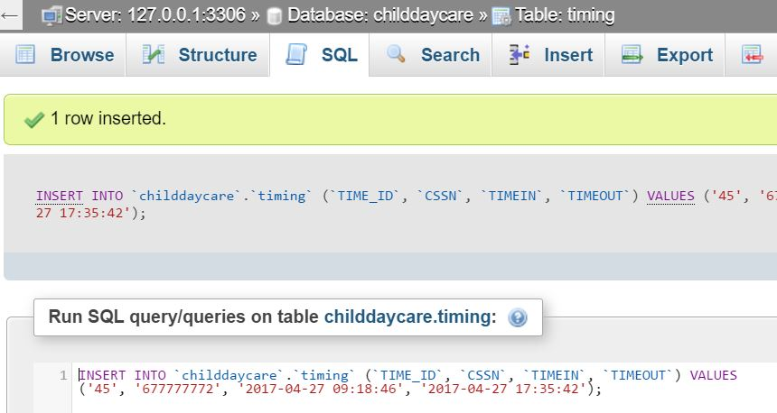
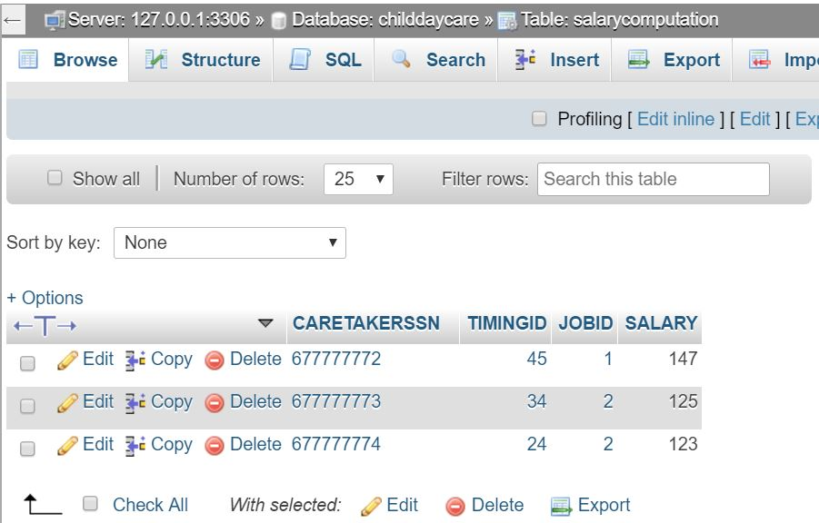
Triggers(Continued)

Slide 22
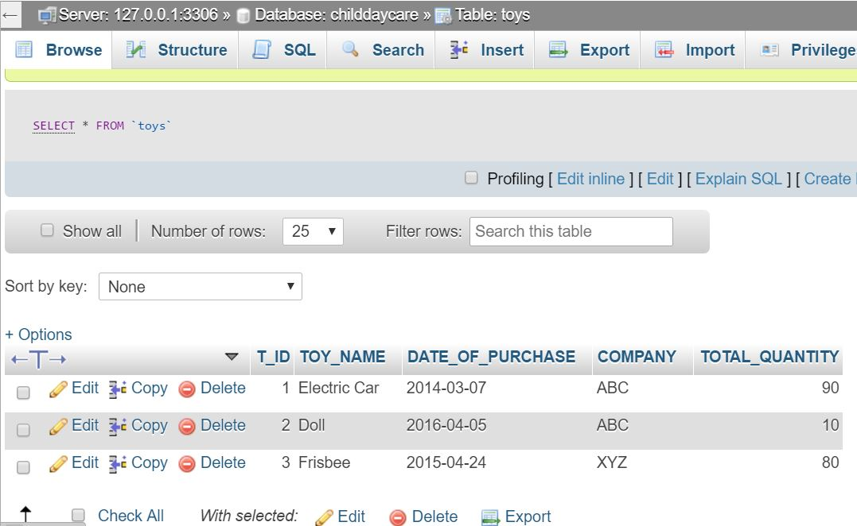
Triggers(Continued)

Slide 23
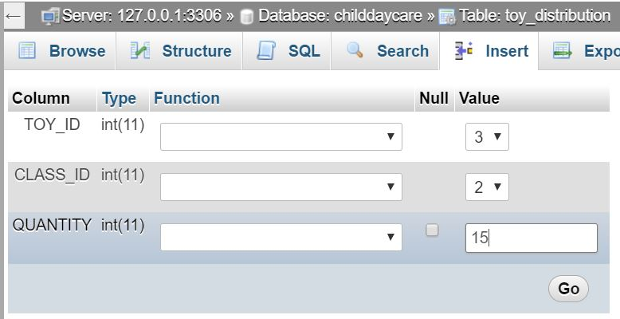
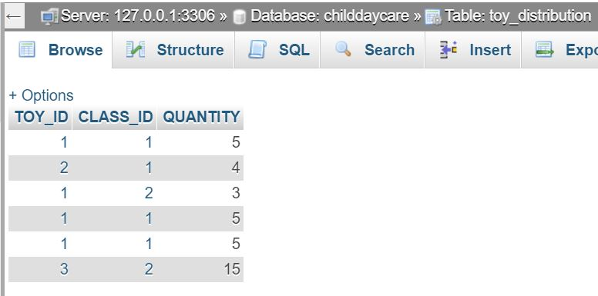
Triggers(Continued)

Slide 24
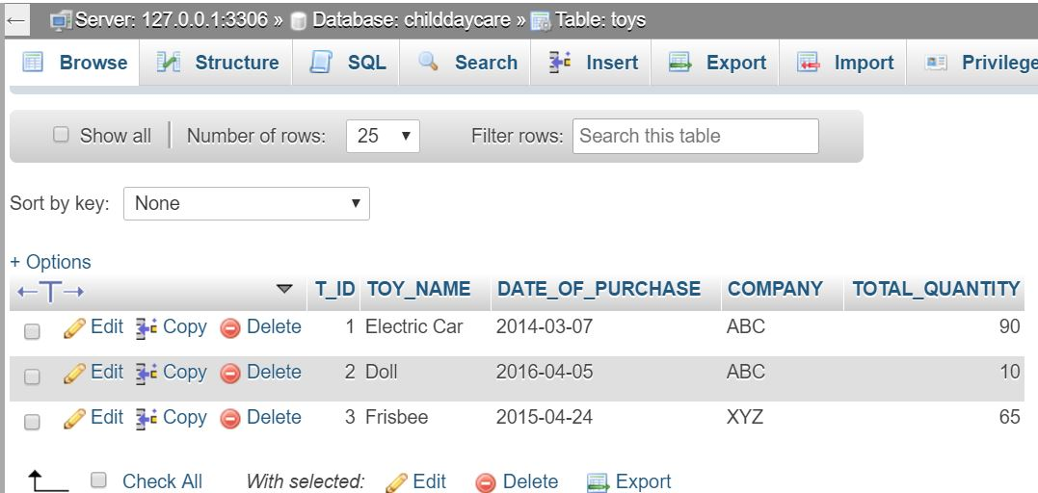
Triggers(Continued)

Slide 25
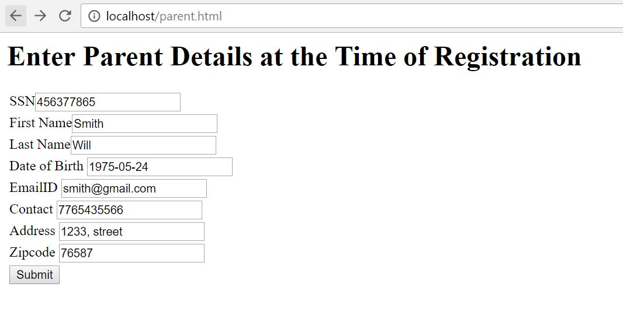
Inserting Values into Parent Table

Slide 26
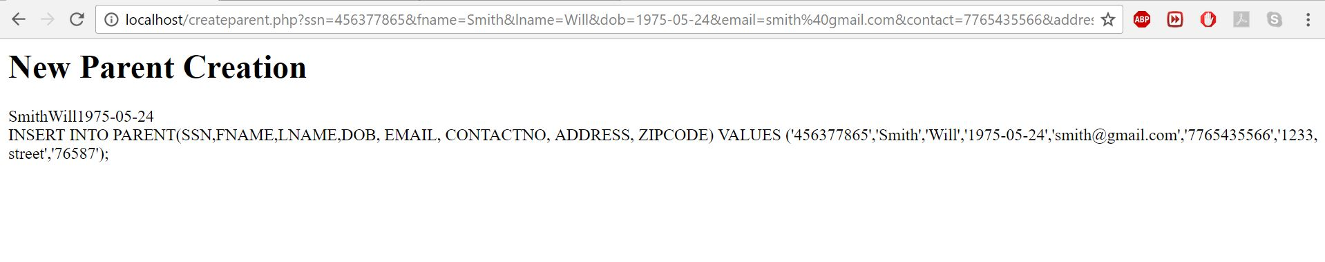
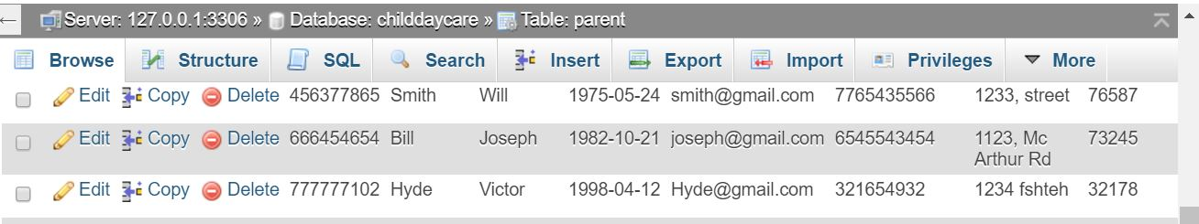
Inserting Values into Parent Table (Continued)

Slide 27
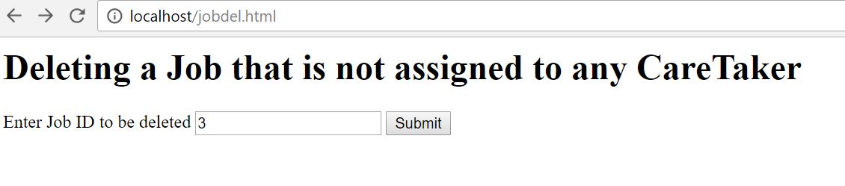
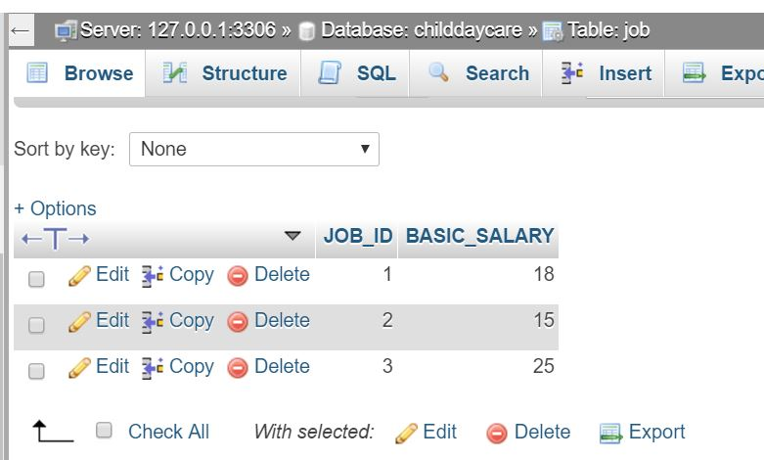
Deleting unnecessary Job from JOB Table

Slide 28
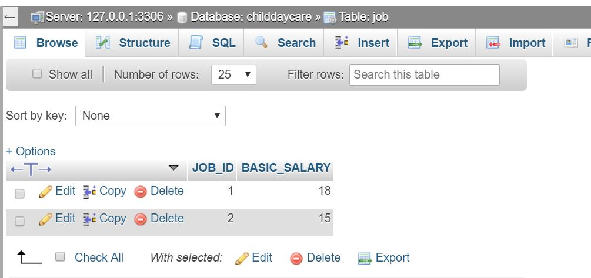
Deleting unnecessary Job from JOB Table(Continued)

Slide 29
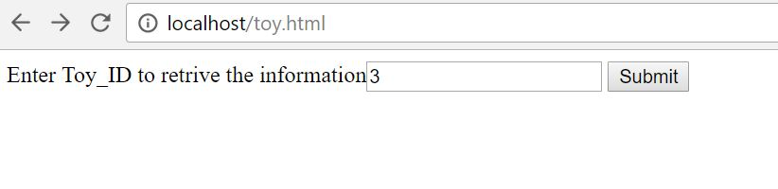
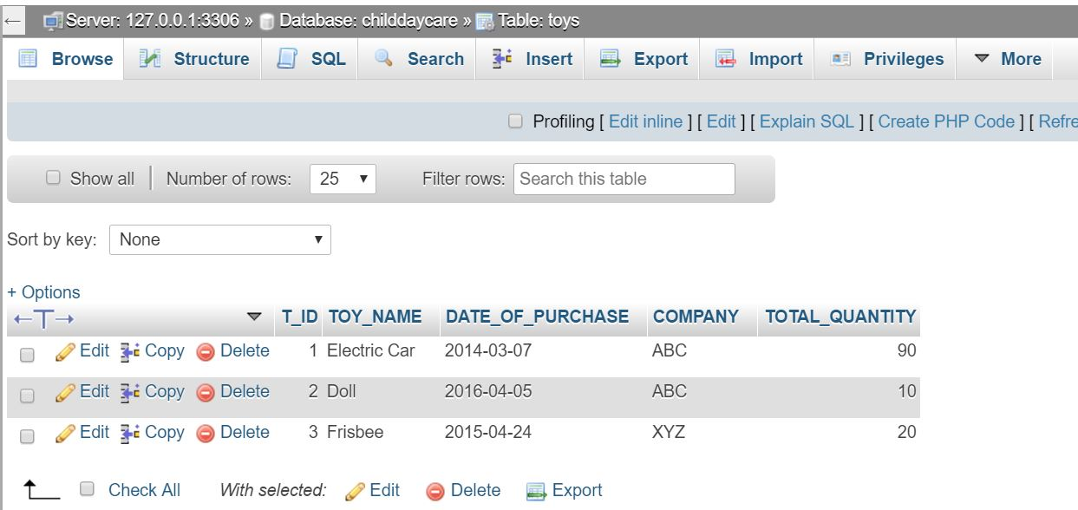
Retrieving Toy Details from Toys Table

Slide 30
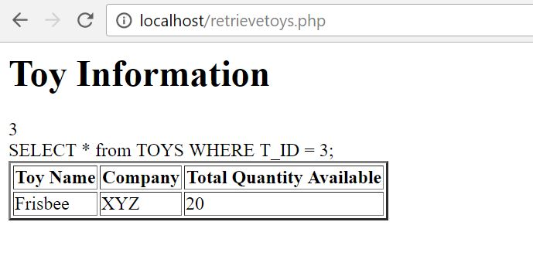
Retrieving Toy Details from Toys Table(Continued)

Slide 31
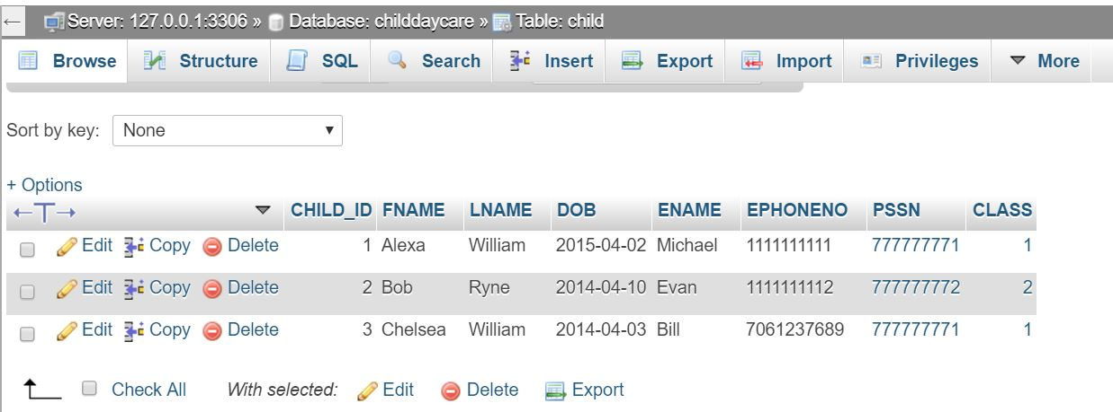
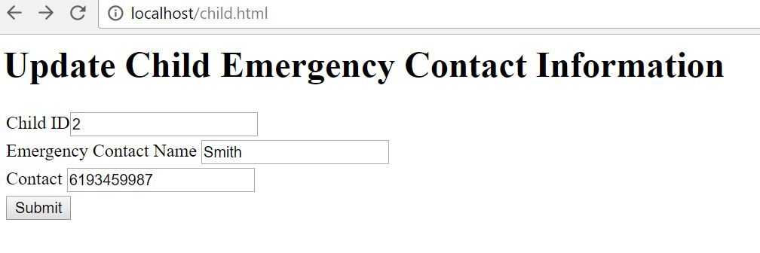
Updating Child Emergency Contact

Slide 32
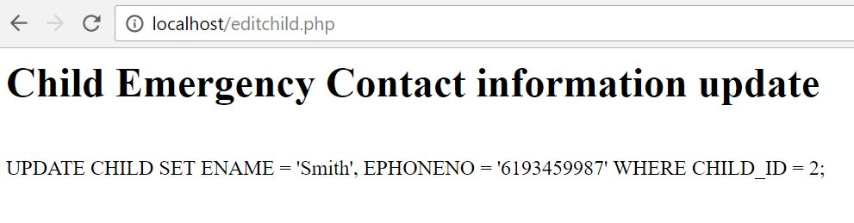
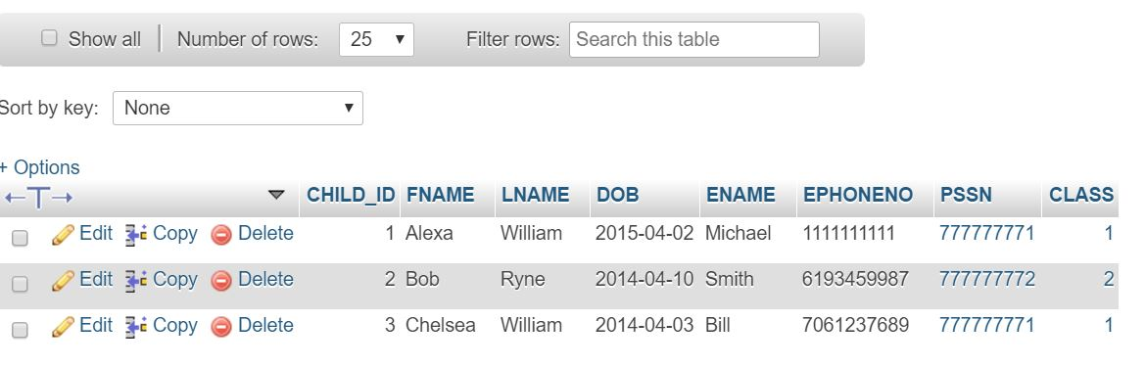
Updating Child Emergency Contact(Continued)

Slide 33
Thank You

